Slide 1
Ctrl-Alt-Biology AIxBio
workshop series
Introduction to Machine Learning
Workshop · Part 1: Introduction & Part 2: Machine Learning & Part 3: Deep Learning

Slide 2
Today's Workshop – 3 Hours
Part 1
Part 2
Part 3
Introduction
Data exploration
Python basics
Hands-on exercises
scikit-learn
Train/test split
kNN & other methods
Deep learning
Autograd & PyTorch
Neural networks

Slide 3
What Are AI and Machine Learning?
Artificial Intelligence: software that mimics intelligent behaviour
Machine Learning: AI that learns patterns from data – no hand-written rules needed
Deep Learning: ML using many-layered neural networks
inspired by the brain
Artificial
Intelligence
Machine
Learning
Deep
Learning
Why does this matter in biology?
ML is transforming genomics, structural biology, drug discovery, and clinical data analysis.

Slide 4
Why Should Biologists Care?
🔬 Protein Structure
🧬 Genomics
AlphaFold predicted 3D structure from sequence – a decades-old problem solved with deep learning.
Disease-variant detection, gene expression prediction, and single-cell analysis at massive scale.
🏥 Clinical Data
💊 Drug Discovery
Tumour classification, drug-response prediction, pathology detection in medical images.
Generating novel molecular candidates and predicting toxicity before synthesis.

Slide 5
Our Dataset – Breast Cancer Wisconsin Diagnostic
A real publicly available clinical dataset. Each row = one tumour biopsy.
569
30
357
212
Patient
biopsies
Measured
features
Benign
cases
Malignant
cases
Features: nucleus radius, texture, perimeter, area, smoothness, compactness, concavity, symmetry … 10 measurements, each as mean / SE / worst = 30 columns total.
Source: UCI ML Repository (ID 17) · W. Street, W. Wolberg, O. Mangasarian, 1995

Slide 6
Key Concept: Features, Targets, and Samples
Sample
radius
texture
…
Diagnosis
#1
14.1
20.3
…
Benign
← Each row = one sample (biopsy)
#2
20.6
17.8
…
Malignant
#3
13.5
22.1
…
Benign
…
…
…
…
↑ Each column = one feature
Features (X): the input measurements – what we give the model Target (y): what we want to predict – Benign or Malignant
The model learns the relationship between X and y from labelled examples

Slide 7
Hands-on – Open the Notebook
Let's open the notebook and start exploring the breast cancer dataset together.
1
Open the shared Google Colab link – runs in your browser, no installation needed
2
Run each cell with Shift + Enter. Read the printed output before moving on.
3
Every code cell has comments explaining what each line does in plain English.
4
We will walk through each section together — follow along in the notebook.
Ask for help if anything is unclear – there are no silly questions!

Slide 8
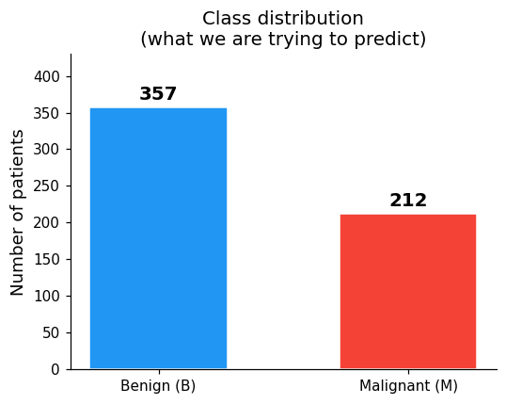
Sections 1.3–1.4 · First Look at the Data
Run the first few cells. Here is what you will see:
X.head() — first 5 rows
Class balance — target variable
30 columns (features), 5 rows
Values vary wildly in scale:
area_mean ≈ 600–2500
smoothness_mean ≈ 0.05–0.16
→ standardisation needed before ML!
What to notice:
• Each row is one patient (biopsy)
• Each column is one measurement
• The Diagnosis column is our target
• Features have very different scales — this is why we will standardise later
62.7% Benign, 37.3% Malignant
Slightly imbalanced — realistic!

Slide 9
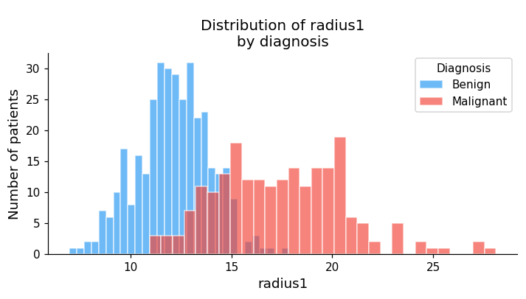
Section 1.5 · Do Features Separate the Classes?
The notebook plots histogram + box plot for radius_mean split by diagnosis:
What you will see
Benign mean radius ≈ 12.1
Malignant mean radius ≈ 17.5
The two distributions clearly separate — large nuclei more often malignant
The box plot shows the spread and outliers for each class
A good feature is one where the two distributions look clearly different — the model can learn to use this separation to classify new patients.

Slide 10
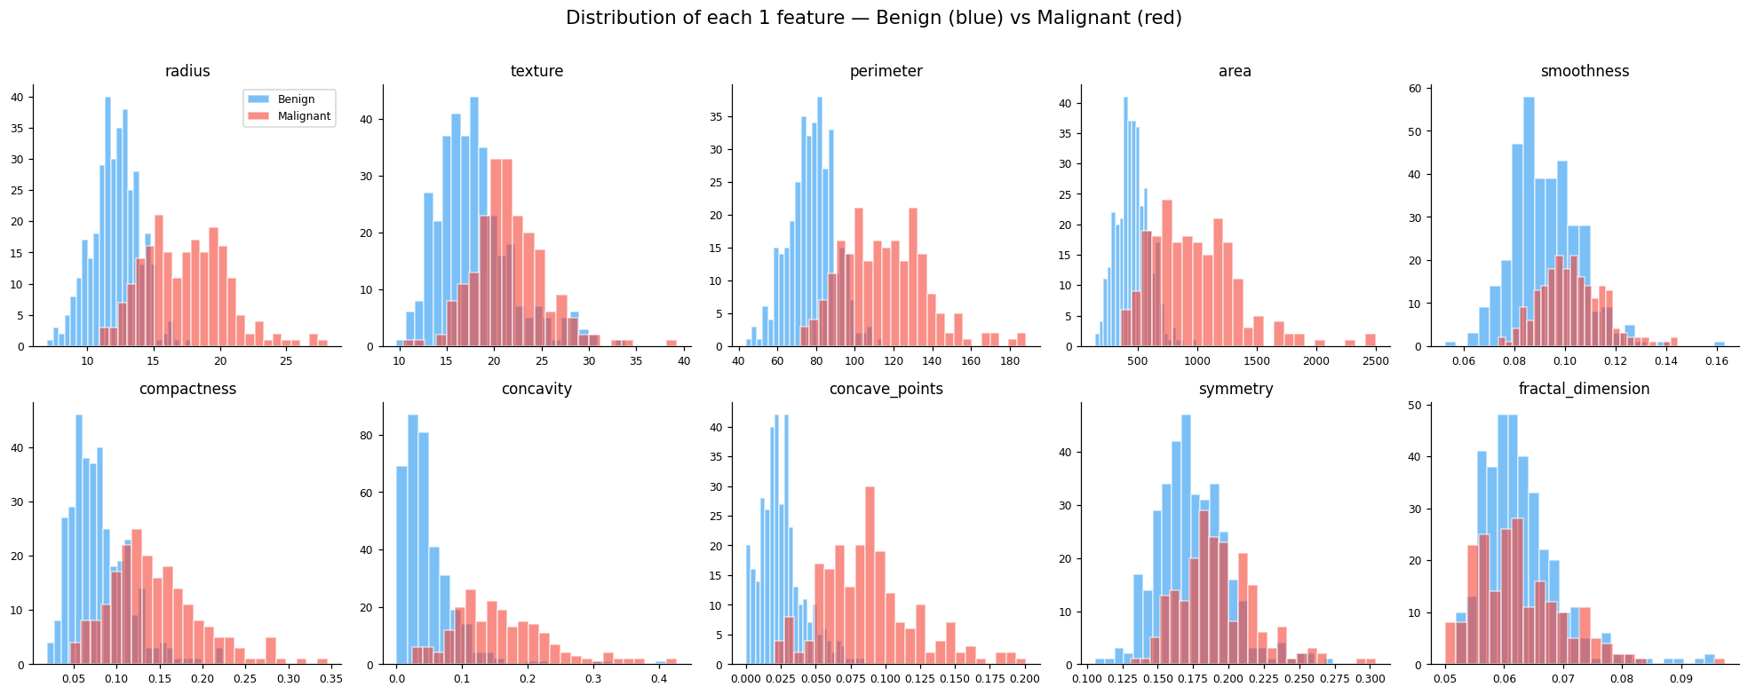
Section 1.6 · All 10 Mean Features at a Glance
= separates well
The notebook shows a 2×5 grid — one histogram panel per mean feature:
= poor separation
radius
texture
perimeter
area
smoothness
compactness
concavity
concave pts
symmetry
fractal dim
radius, perimeter, area, concavity, concave points separate well — fractal dimension and symmetry don't.

Slide 11
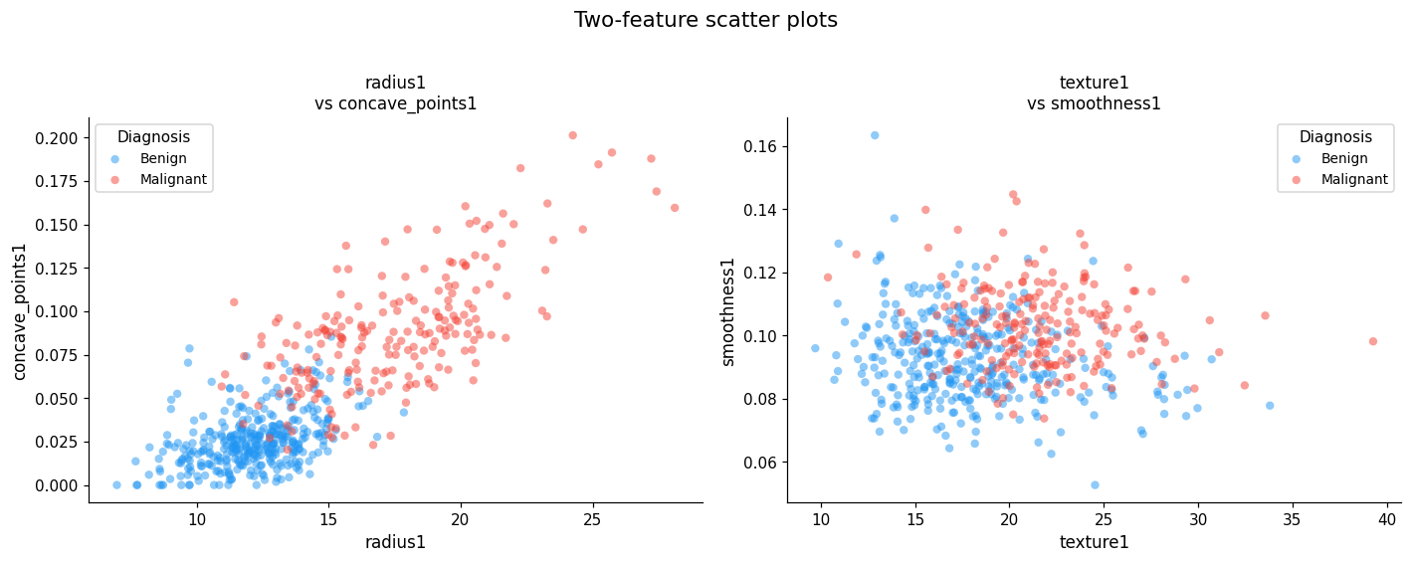
Section 1.7 · Scatter Plots — Two Features at Once
Scatter plots show whether two features together can separate the classes:
✅ Good separation
A line can roughly divide the two groups
⚠️ Poor separation
Both groups mix -> hard to classify

Slide 12
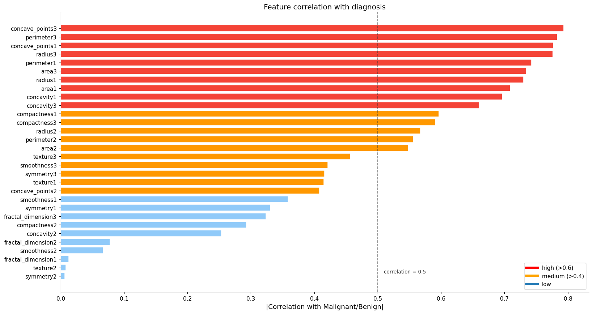
Section 1.8 · Which Features Predict Malignancy Best?
The notebook computes the correlation of each feature with the Malignant/Benign label:

Slide 13
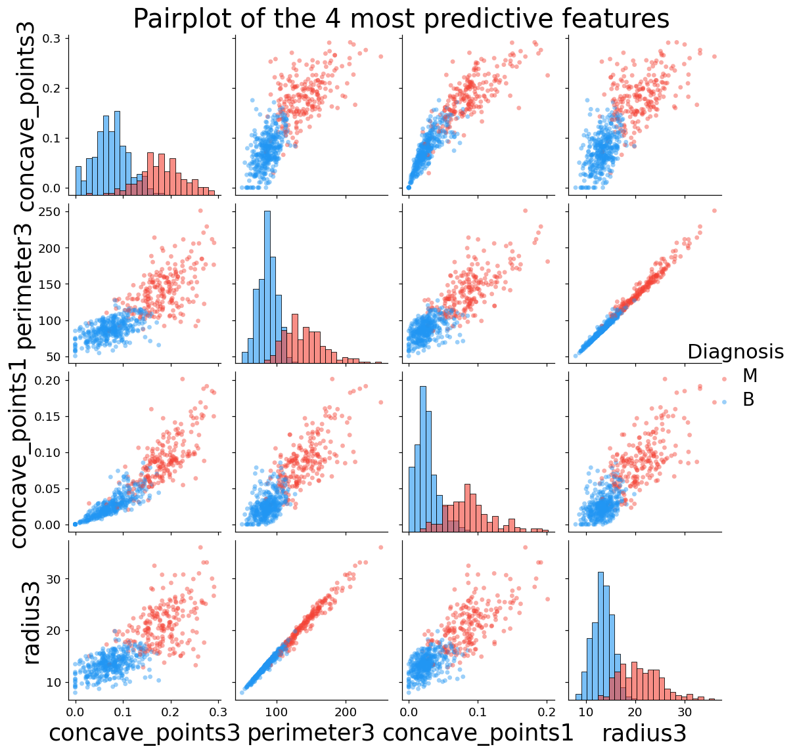
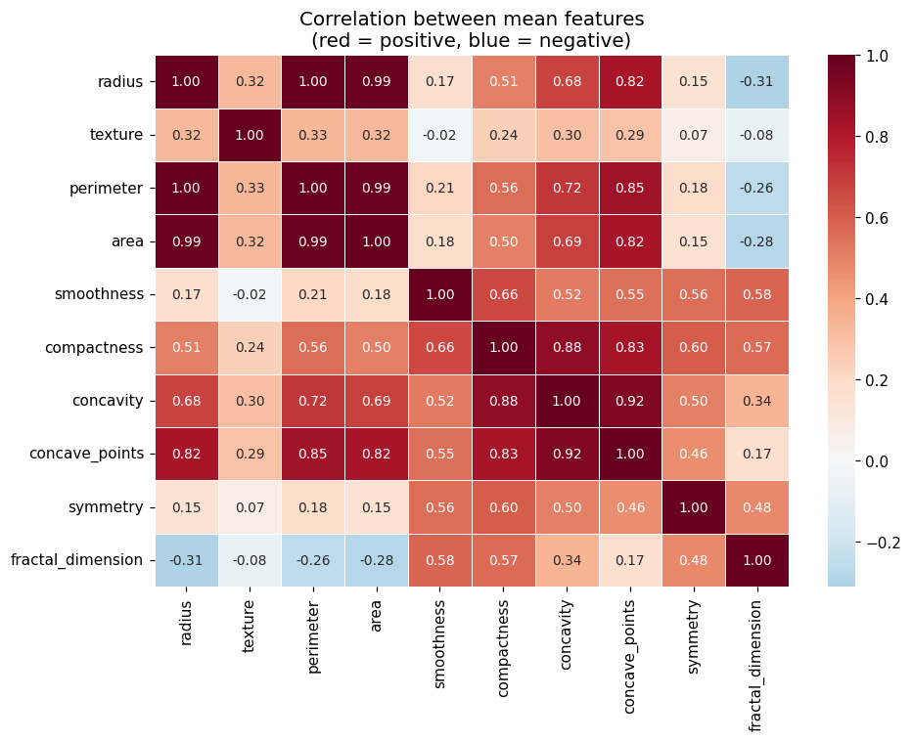
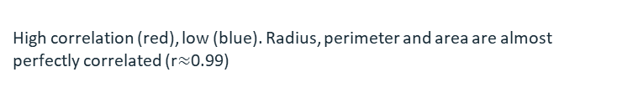
Sections 1.9–1.10 · Pairplot & Correlation Heatmap
Pairplot — top 4 features (Section 1.9)
Correlation heatmap — mean features (Section 1.10)
Each off-diagonal panel is a scatter plot of two features.
Features separate Benign (blue) and Malignant (red) clearly in most panels.
High correlation (red), low (blue). Radius, perimeter and area are almost perfectly correlated (r$≈$0.99)

Slide 14
Exercise 1 — Explore a Feature
Section 1: change one variable and re-run
Your task:
Change the feature variable in the Exercise 1 cell and re-run it. Compare two features from each group:
Type
Feature name (copy exactly)
What you should see
High correlation
'concave_points1'
Classes separate very clearly
High correlation
'perimeter3'
Another strong predictor
Low correlation
'fractal_dimension1'
Almost complete overlap
Low correlation
'symmetry1'
Little separation — try it!
Bonus: can a feature with low correlation still add value when combined with other features?

Slide 15
Part 2 – Machine learning with scikit-learn
Implementing and evaluating models.

Slide 16
How Does a Model Learn?
Input
Features (e.g. area, perimeter..)
Fit the model
(maths)
Prediction (M or B)
Compare with
true label (M or B)
→
→
→
If prediction is wrong → adjust model parameters (this is learning!)
Parameters: numbers inside the model that get adjusted during training Loss function: a score for how wrong the model is – we want to minimise it Training: predict → measure loss (how many predictions am I getting right?) → update parameters → repeat

Slide 17
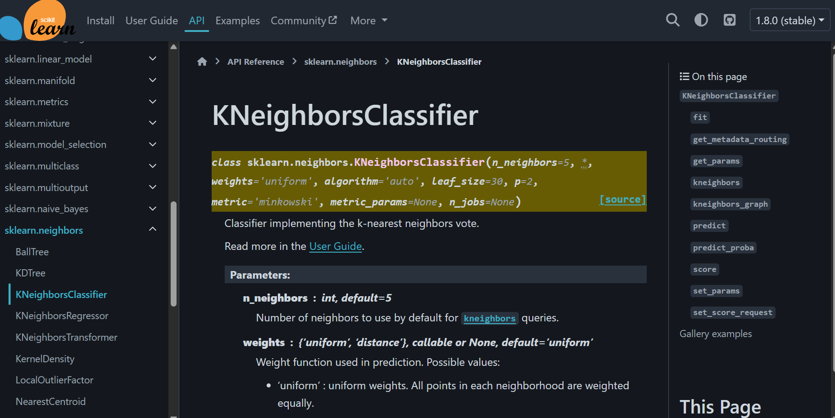
Section 2.1· implementing a model with the scikit-learn API
Scikit-learn is a package that provides an easy framework for data pre-processing, model selection and implementation of various ML algorithms. We are going to use some models in this session, but many others are available. Check them out on your own time at the website. Let's go through the basic steps for implementing any model in the notebook now.
Screenshot of the sklearn website, showing the documentation of the k-Nearest Neighbor classifier model that we are going to implement.

Slide 18
Section 2.2· splitting the data into train and test
The idea behind fitting a model to our data is that we will be able to unveil interesting insights about said data and/or that we will be able to generalise those learnings to cases we haven't seen yet.
How do we assess that? If we use the whole dataset to train, we may overfit, that is, learn quirks about the individual cases we train on, that will not be useful in patients that we have not seen yet.
Train
Test
Get a sense of how good these relationships are at diagnosing patients the model has not seen before.
Use to learn relationships between input features and diagnostic
We usually split datasets into 70-30, 75-25, 80-20 (train-test) ratios.

Slide 19
Exercise 2 — train and evaluate the kNN on the train-test splits
Your task:
Re-train the kNN model on the right data splits and evaluate. What accuracy do we get now?

Slide 20
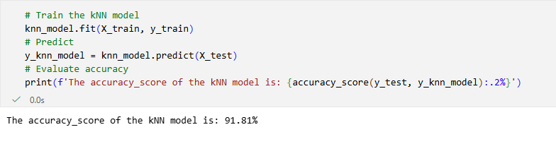
Exercise 2 — train and evaluate the kNN on the train-test splits
Your task:
Re-train the kNN model on the right data splits and evaluate. What accuracy do we get now?

Slide 21
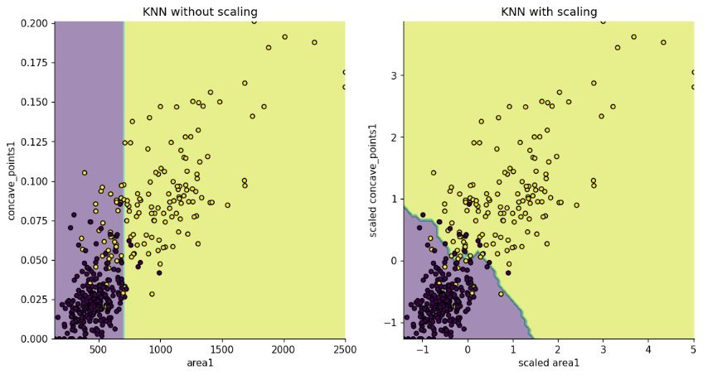
Section 2.3 · k-Nearest Neighbor (kNN) and feature scaling
We can see the importance of feature standardisation in this example; without it, the model only attends to the feature which has the largest scale and misses some information captured by the other feature.

Slide 22
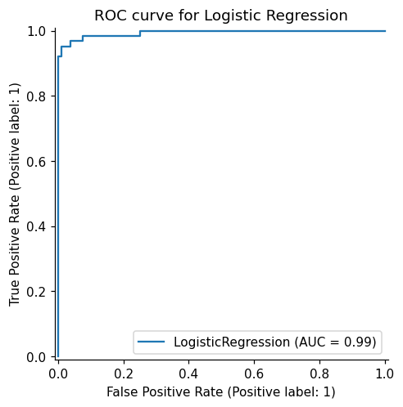
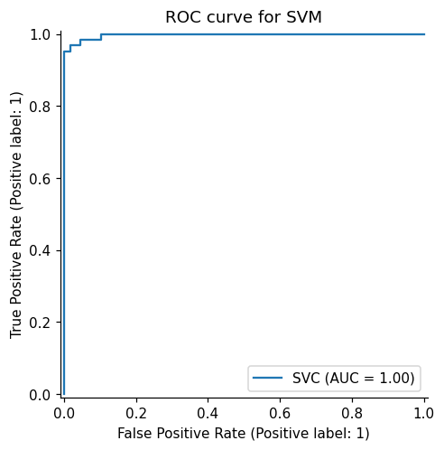
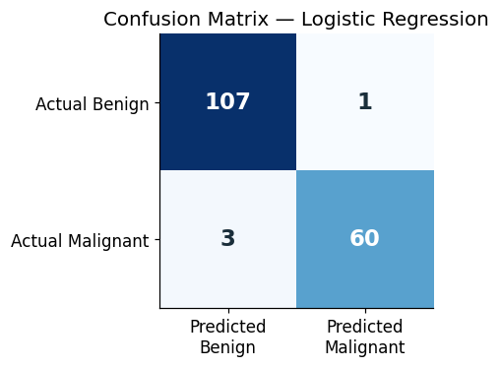
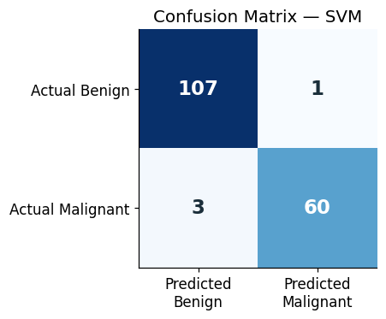
Sections 2.4-2.5 · Logistic Regression and SVM (validation metrics)
Accuracy measures the fraction of correctly classified tumors at a fixed decision threshold.
We can plot a receiver operating characteristic (ROC) curve to show the trade-off between catching real positives and triggering false alarms at different thresholds.
False Positive Rate (FPR), of all truly benign tumors, what fraction did the model incorrectly label as malignant?
True Positive Rate (TPR), of all truly malignant tumors, what fraction did the model correctly identify as malignant?
In this case, the two models perform really similarly, but their performances will differ more depending on the dataset.

Slide 23
Part 3 – Deep Learning with PyTorch
Backpropagation, automatic differentiation, and neural networks

Slide 24

Gradient Descent – Finding the Minimum
Imagine you're blindfolded on a hilly landscape and want to reach the lowest valley.
Feel the slope under your feet → this is the gradient Take a small step downhill → this is one parameter update Repeat until you can't go lower → the model has learnt!
You might find yourself in a local minimum!

Slide 25
Gradient Descent – Finding the Minimum
Imagine you're blindfolded on a hilly landscape and want to reach the lowest valley.
Feel the slope under your feet → this is the gradient Take a small step downhill → this is one parameter update Repeat until you can't go lower → the model has learnt!
In that case, you will need to explore the landscape more to reach a global minimum

Slide 26
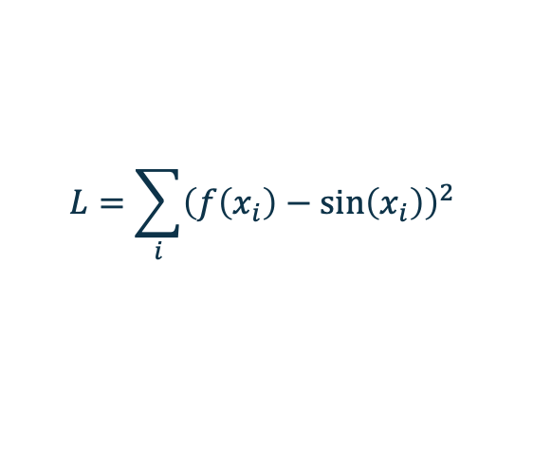
Section 3.1 — The Setup: Fitting a Polynomial
We want to find a, b, c, d such that:
f(x) = a + bx + cx² + dx³ ≈ sin(x)
We measure how wrong we are with the loss (sum of squared errors):
$$L=\sum_{i}{{\left(f\left(x_{i}\right)−\sin\left(x_{i}\right)\right)}^{2}}$$
• If the prediction is too high, the loss is large — the model needs to be penalised
• Gradient descent will nudge a, b, c, d to make L smaller on every step
• We need the gradient (slope) of L with respect to each parameter

Slide 27

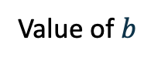
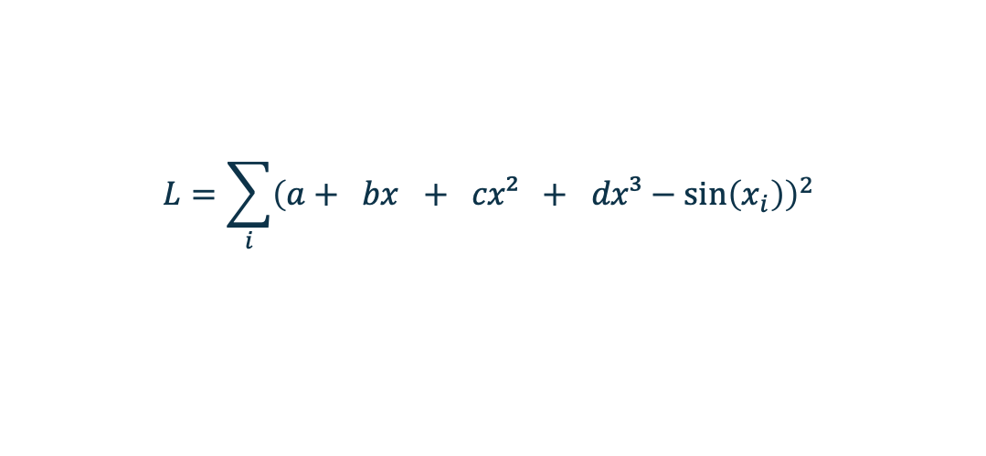

Section 3.1 — Loss Function of Polynomial Fitting
$$L=\sum_{i}{{\left(a+ bx + cx² + dx³−\sin\left(x_{i}\right)\right)}^{2}}$$
$$L$$
$b^{ }$
Step 1→ Calculate the gradient/slope
Step 2 → Update the parameter using this gradient Repeat until you can't go lower
Value of $b$

Slide 28
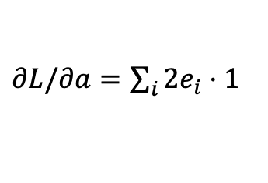

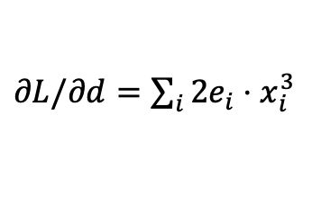
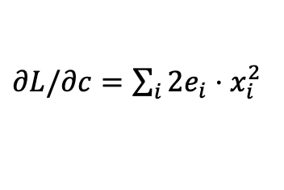
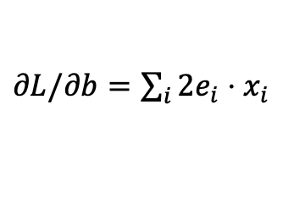
Computing Gradients by Hand — The Chain Rule
How does each parameter affect the loss? Chain rule:
Step 1 — Error at each point: eᵢ = f(xᵢ) − sin(xᵢ) → dL/df = 2·eᵢ
$∂L/∂a=\sum_{i}{2e_{i}⋅1}$
$∂L/∂b=\sum_{i}{2e_{i}⋅x_{i}}$
(∂f/∂a = 1)
(∂f/∂b = x)
$∂L/∂c=\sum_{i}{2e_{i}⋅x_{i}^{2}}$
$∂L/∂d=\sum_{i}{2e_{i}⋅x_{i}^{3}}$
(∂f/∂c = x²)
(∂f/∂d = x³)
Step 2 — Update: (same for b, c, d)
$a←a−α⋅$ $∂L/∂a$
α = learning rate (step size)

Slide 29
Hand-Written Backprop — The Code
Each line directly implements one gradient formula — compare with previous slide:
# Forward pass
y_pred = a + b*x + c*x**2 + d*x**3
loss = (y_pred - y_true).pow(2).sum()
# ── BACKPROP (chain rule, by hand) ──────────────────────
grad_y_pred = 2.0 * (y_pred - y_true) # dL/df = 2·error
grad_a = grad_y_pred.sum() # dL/da = Σ 2·e · 1
grad_b = (grad_y_pred * x).sum() # dL/db = Σ 2·e · x
grad_c = (grad_y_pred * x**2).sum() # dL/dc = Σ 2·e · x²
grad_d = (grad_y_pred * x**3).sum() # dL/dd = Σ 2·e · x³
# ── PARAMETER UPDATE ─────────────────────────────────────
a -= learning_rate * grad_a
b -= learning_rate * grad_b
This works! But imagine doing this for a million parameters in a neural network…

Slide 30
What You Will See — Intermediate Output
The notebook prints a table at steps 1, 100, 500, 1000, 2000 — watch convergence:
Step Loss a b c d
----------------------------------------------------------
1 975424.4 2.2170 -1.1559 0.3438 -1.6618
100 4934.8 1.7657 -0.5725 -0.3044 0.1100
500 1115.9 0.8842 0.2318 -0.1525 -0.0044
1000 184.3 0.3725 0.6345 -0.0643 -0.0617
2000 13.5 0.0661 0.8286 -0.0114 -0.0893
Final: y = 0.0660 + 0.8287x + -0.0114x² + -0.0893x³
True: sin(x) ≈ 0 + 1·x + 0·x² − 0.1667·x³
See how the sequence converges to the true (Taylor approximation) of the sine function!

Slide 31
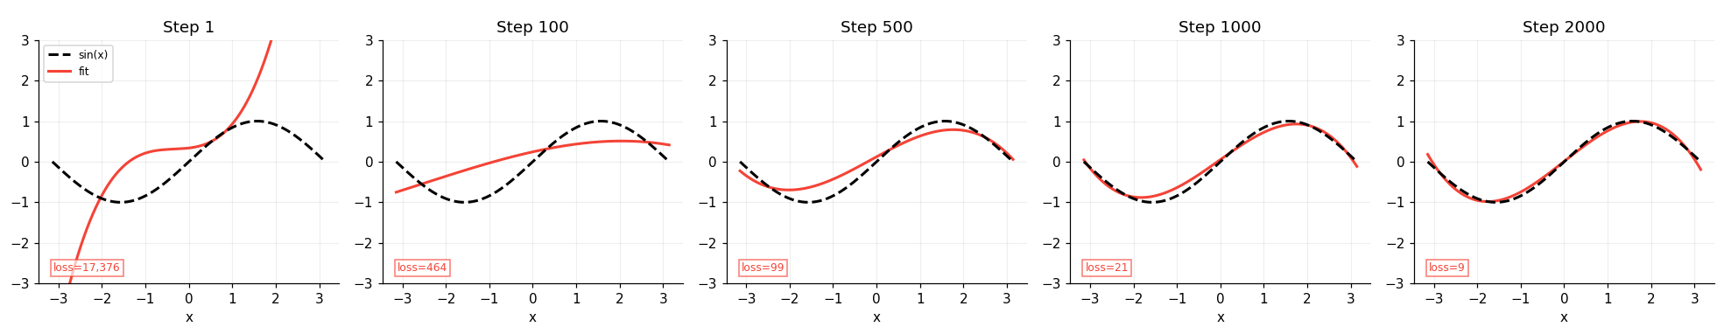
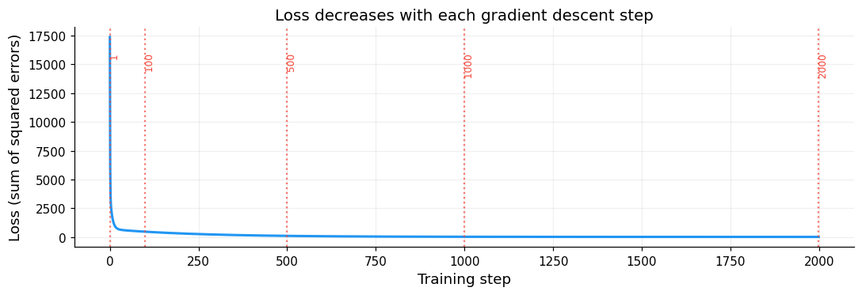
What You Will See — Intermediate Output
And a 5-panel plot shows the polynomial at each step — random chaos → smooth sine wave:

Slide 32
Exercise A (optional) — Hand-Written Backprop
Run Section A — see gradient descent converge step by step
Run the Section A cells in order (Shift+Enter each cell)
1
Read the printed table — watch the loss drop from ~1,000,000 to ~13 over 2000 steps
2
Look at the 5-panel snapshot plot — compare Step 1 (random) to Step 2000 (converged)
3
Notice: the final b ≈ 1.0 and d ≈ −0.167, which match the true Taylor coefficients of sin(x)
4
Discussion: Which parameter changed fastest? Look at the table — why does b converge quickly while a stays near zero?

Slide 33
From Hand-Written to Automatic Differentiation
Hand-written backprop has a fundamental problem at scale:
❌ Without autograd
✅ With PyTorch autograd
❌ Tedious — derive every gradient formula by hand
❌ Error-prone — one wrong sign breaks silently
❌ Non-reusable — rewrite for each architecture
❌ Impossible to scale to millions of parameters
✅ Records every op on requires_grad tensors
✅ loss.backward() applies chain rule automatically
✅ Works for any architecture or loss function
✅ Scales to billions of parameters
The gradients are identical — autograd is just calculus done automatically

Slide 34
Autograd — What Changes in the Code
Only three things change — highlighted with ← AUTOGRAD:
Before — hand-written
After — autograd
a = torch.randn(()) # plain tensor
b = torch.randn(())
loss = (y_pred - y_true).pow(2).sum()
# Manual gradients
grad_a = 2*(y_pred-y_true).sum()
grad_b = (2*(y_pred-y_true)*x).sum()
a -= lr * grad_a
b -= lr * grad_b
a = torch.randn((),
requires_grad=True) # ← 1
b = torch.randn((),
requires_grad=True) # ← 1
loss = (y_pred - y_true).pow(2).sum()
loss.backward() # ← 2
with torch.no_grad():
a -= lr * a.grad # ← 3
a.grad.zero_()

Slide 35
The Full Training Loop — Standard Pattern
With an optimiser, the update step is also automated:
1+2
Forward: compute prediction
and measure error
optimizer = torch.optim.Adam([a, b, c, d], lr=0.05)
for step in range(500):
y_pred = a + b*x + c*x**2 + d*x**3 # 1. Forward
loss = (y_pred - y_true).pow(2).mean() # 2. Loss
optimizer.zero_grad() # 3. Reset gradients
loss.backward() # 4. Autograd fills .grad
optimizer.step() # 5. Update parameters
3
Clear old gradients
(PyTorch accumulates)
4
Autograd fills .grad
for every parameter
5
Nudge params opposite
to gradient direction

Slide 36
Exercise A2 — Same with Autograd
Replace hand-written gradients — does the result match?
What to do and observe:
1
Run Section A2 cells — notice requires_grad=True is the only change to the setup
2
The loop now prints a.grad and b.grad — compare these to grad_a, grad_b from Section A
3
The overlay plot shows both loss curves — they should sit exactly on top of each other
4
Final parameters should match Section A to 4 decimal places
Key insight: the gradient values in the printout are numerically identical between hand-written and autograd.
This proves autograd is simply automating the same calculus — not doing something magical.

Slide 37
Exercise 3 — Change the Target Function
One line of code — see how polynomial limits show up
Change this one line in the Exercise 2 cell and re-run:
y_true_ex = torch.sin(x_ex) # CHANGE THIS LINE
Function
Difficulty
What to look for in the plot
torch.cos(x)
Easy
Should fit well — cosine has a similar Taylor series
torch.sin(2*x)
Medium
Fits near x=0 but diverges near ±π — higher frequency needs more terms
torch.abs(x)
Hard
Polynomial is smooth; abs(x) has a sharp kink at 0 — watch the mismatch
torch.tanh(x)
Bonus
S-shaped — where does the cubic give up?
Key insight: neural networks use many small non-linear units — they can fit far more complex functions than a cubic.

Slide 38
Section 3.2 — Linear Classifier: Predicting Malignancy
We now apply the same gradient-descent machinery to a real medical problem.
Step 1 — Prepare the data
Step 2 — The model
1
Encode target
Input
Benign → 0, Malignant → 1
30 standardised features
↓
2
Standardise features
Weighted sum
Mean 0, std 1 — makes gradient descent converge much faster
w₁·x₁ + w₂·x₂ + … + w₃₀·x₃₀ + bias
↓
3
Train / test split
Sigmoid
80 % train (455 pts), 20 % test (114 pts), stratified
1 / (1 + e⁻ᶻ) → value between 0 and 1
↓
Output
This is logistic regression
P(Malignant) threshold at 0.5

Slide 39



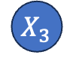
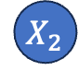
Section 3.2 — The Model in Code
This model is actually a neural network of a single layer! See below:
$${ X}_{1}$$
Because of this, we can easily define the model in three lines and PyTorch handles the rest:
$$∑W_{i}X_{i}$$
$$Y$$
$${ X}_{2}$$
Notebook output
$${ X}_{3}$$
Sigmoid function
Model architecture:
Sequential(
(0): Linear(in=30, out=1)
(1): Sigmoid()
)
Total parameters: 31
(30 weights + 1 bias)
Training set: 455 patients
Test set : 114 patients
Model architecture
linear_model = nn.Sequential(
nn.Linear(30, 1),# 31 params
nn.Sigmoid() # squash output to [0, 1]
)
criterion = nn.BCELoss() # Loss
optimizer = torch.optim.Adam(
linear_model.parameters(), lr=0.01)

Slide 40
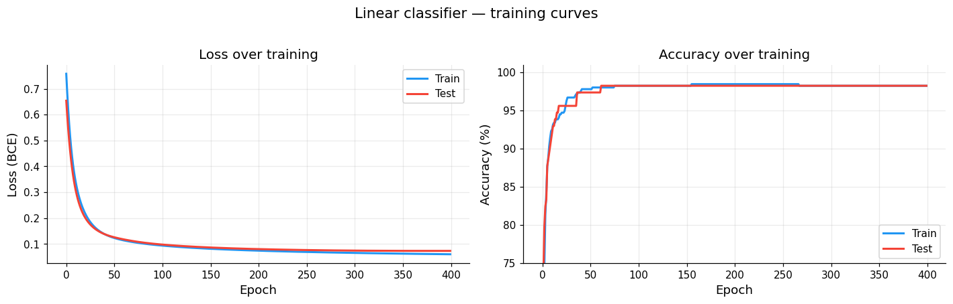
Section 3.2 — Training Output & What the Plots Show
The training loop prints a table every 50 epochs — same structure as the polynomial:
📉 Loss curve (left plot)
📈 Accuracy curve (right plot)
• Train loss (blue) and test loss (red) both fall steadily
• Starts at ~64% (close to random — untrained weights)
• They stay close together — no overfitting
• Crosses 90% around epoch 10
• The steep drop in the first 50 epochs is the model learning the obvious cases
• Train and test accuracy track each other well
• After ~200 epochs the curve flattens — diminishing returns
• Final ~98%: 2 in 100 patients misclassified

Slide 41
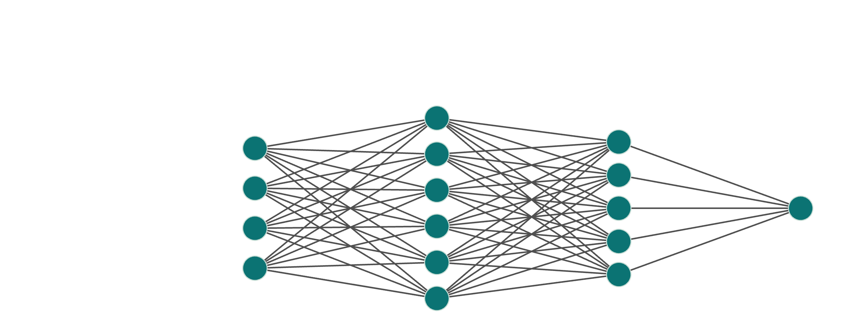
What is a Neural Network?
Many layers of simple operations stacked together – trained by gradient descent.
Output
P(M)
Input
(30)
Hidden
32
Hidden
64
• Each node: weighted sum of inputs → ReLU activation (max(0, x))
• Deeper networks can learn complex non-linear patterns a linear model cannot
• Trained with the exact same gradient descent loop — autograd handles all gradients

Slide 42
Section 3.3 — Coding Neural Networks
We will next add two hidden layers to our architecture, with a ReLu actication function in between:
Model architecture
neural_net = nn.Sequential(
nn.Linear(30, 64),
#hidden layer 1: 30 → 64 neurons
nn.ReLU(),
nn.Linear(64, 32),
#hidden layer 2: 64 → 32 neurons
nn.ReLU(),
nn.Linear(32, 1),
#output layer: 32 → 1
nn.Sigmoid()
)
criterion = nn.BCELoss()
optimizer = torch.optim.Adam(
neural_net.parameters(), lr=0.005)
Network structure
Input (30 features)
↓
[Linear 30→64] → ReLU ← Hidden layer 1
↓
[Linear 64→32] → ReLU ← Hidden layer 2
↓
[Linear 32→1] → Sigmoid
↓
Output: P(Malignant)
This is very easy to code in PyTorch since we only need to say the dimensions of the network that we are adding ->

Slide 43
What You Will See — Training Progress
Both models print accuracy every 50 epochs so you can watch the model improve:
Epoch Train Loss Test Loss Train Acc Test Acc
--------------------------------------------------------
1 0.6981 0.6574 38.2% 71.1%
50 0.0294 0.0870 99.3% 98.2%
100 0.0029 0.1653 100.0% 97.4%
150 0.0008 0.2239 100.0% 97.4%
200 0.0004 0.2531 100.0% 97.4%
250 0.0002 0.2745 100.0% 97.4%
300 0.0001 0.2913 100.0% 97.4%
350 0.0001 0.3054 100.0% 97.4%
400 0.0001 0.3180 100.0% 97.4%
Neural net — train accuracy : 100.0%
Neural net — test accuracy : 97.4%
• Train and test accuracy should stay close — a big gap means overfitting
• Early epochs: steep drops (fast initial learning)
• Final test accuracy ~96% means the model correctly classifies 96 out of 100 new patients
• The confusion matrix then shows exactly which ones it got wrong — and what type of mistake

Slide 44
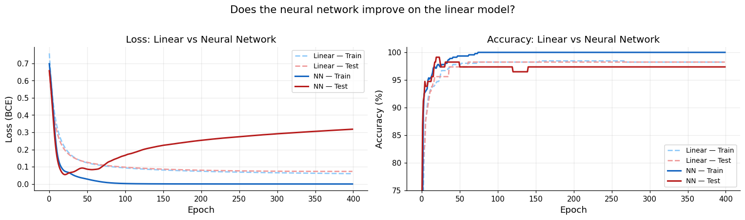
Comparison with Linear model
We can now compare the simple logistic regression with the 2-hidden layers neural network:
What do you observe? The neural network seems to be overfitting to the data!
The linear model performs very similarly in the train and test, but the neural network does better in the train (overfits to it, since it attains a perfect score!) and then underperforms in the test set. Beware of complex models!

Slide 45
Exercise 4 — Classify Tumours
Run Sections 3.2 and 3.3 — compare linear model vs neural network
Work through both models and discuss these questions:
Q1
At what epoch does test accuracy first exceed 90%? Is there a gap with train accuracy?
Q2
Look at the confusion matrix — how many malignant cases did the model miss (false negatives)?
Q3
Sensitivity vs specificity: which matters more clinically? What trade-off would you make?
Q4
The neural network has ~80× more parameters than the linear model. Does it do better?
Q5
Why might a linear model already achieve ~98% on this dataset?

Slide 46
Exercise 5 / 6 — Design Your Own Network
Modify the architecture in Exercise 3 and compare
Change one or more things at a time — compare to the baseline neural network:
What to change
Code change
Expected effect
Add a third hidden layer
nn.Linear(32,16), nn.ReLU()
More capacity — does it help or overfit?
Widen first layer
nn.Linear(30, 128)
Bigger representations — faster convergence?
Smaller learning rate
lr=0.001
Slower but smoother — lower final loss?
Larger learning rate
lr=0.02
Faster start — might oscillate?
Train for longer
range(800)
Does accuracy still improve after 400 epochs?
Medical context: if you improve accuracy by 0.5% but sensitivity drops by 2% — is that a good trade?

Slide 47
What We've Covered Today
✓
What AI, ML, and deep learning are – and why they matter in biology
✓
How to explore a real clinical dataset: distributions, correlations, predictive features
✓
How to use Scikit-Learn to train/test split our data
✓
Using different ML methods from Scikit-Learn
✓
How to train a linear classifier to predict tumour malignancy
✓
How to build and train a neural network with hidden layers

